Slide 1

Intelligent Urban Mobility Analytics Using GPS and Traffic Data​
BATCH NO – 07
Team members
2420030066 - P.Likhith Sai
2420030225 - Sanivarapu Sadhana
2420030336 - M.Pavani Sree
2420030780 - B.Sai Bharghav Reddy

Slide 2
Problem Statement
Rapid urbanization and the growing number of vehicles have led to traffic congestion, road accidents, and longer travel times, affecting road safety and transportation efficiency. Existing systems often analyze GPS, weather, and accident data separately, limiting comprehensive mobility analysis.
This project develops an Intelligent Urban Mobility Analytics platform that integrates GPS trajectory, weather, and road accident data to analyze mobility patterns, predict accident risks, and provide actionable insights through an interactive dashboard for smarter transportation planning.

Slide 3
Objectives
To integrate GPS trajectory, weather, traffic, and road accident data to provide a comprehensive view of urban mobility.
To analyze travel patterns and examine how weather conditions, traffic conditions, and road factors influence mobility and accident risks.
To apply and compare machine learning models for accident-risk prediction and identify the model with better predictive performance.
To analyze accident-prone locations and mobility patterns using geospatial visualizations and analytical techniques.
To present mobility patterns, accident hotspots, prediction results, geospatial visualizations, and analytical reports through an interactive dashboard for better transportation planning.
To provide a foundation for real-time mobility monitoring by enabling future integration of live GPS and traffic data for dynamic transportation analysis.

Slide 4
Literature Survey
Paper | Publication | Key Contribution | Limitation
A Prediction Model for Expressway Traffic Accidents Under Extreme Weather Conditions Using SVM (2024) | SAGE – Journal of Computational Methods in Sciences and Engineering | Studies the relationship between extreme weather and traffic accidents and applies an optimized SVM model for prediction. | Focuses on expressways and extreme weather, limiting its applicability to broader urban mobility scenarios.
From Prediction to Prevention: Leveraging Deep Learning in Traffic Accident Prediction Systems (2023) | MDPI – Electronics | Uses CNN and DNN for urban accident prediction and addresses the challenge of imbalanced accident data. | Mainly focuses on accident prediction and severity, with limited integration of multiple urban data sources..
Traffic Accident Risk Prediction Based on Deep Learning and Spatiotemporal Features of Vehicle Trajectories (2025) | PLOS ONE | Uses CNN, LSTM and GNN with vehicle trajectory features such as speed, acceleration and location for accident-risk prediction. | Uses mainly vehicle trajectory and traffic-network information and does not provide a unified GPS + weather + accident analytics platform

Slide 5
Literature Survey
Paper | Publication | Key Contribution | Limitation
An Explainable Machine Learning Approach to Traffic Accident Fatality Prediction (2024) | Procedia Computer Science | Compares machine-learning models including Logistic Regression, Random Forest, and Decision Tree for traffic accident fatality prediction. | Focuses on fatality classification rather than comprehensive urban mobility, GPS analysis, weather impact, and integrated dashboard analytics.
A Methodological Framework for Road Accident Severity Prediction for Indian Highways Using Machine Learning Models (2025) | Elsevier – MethodsX | Uses Random Forest and Gradient Boosting for accident-severity prediction using factors such as vehicle type, weather, and road conditions | Focuses mainly on accident severity on Indian highways rather than general urban mobility and route analysis.
Urban Flow Prediction from Spatiotemporal Data Using Machine Learning: A Survey (2020) | Elsevier – Information Fusion | Reviews machine-learning approaches for urban spatiotemporal flow prediction, focusing on traffic management, public safety, datasets, algorithms, and evaluation methods. | Focuses primarily on traffic-flow prediction and does not integrate accident, weather, and GPS analysis into one platform.

Slide 6
Research Gap Identification
Fragmented Mobility Data: Existing systems often analyze GPS, weather, traffic, and road accident data independently, making it difficult to obtain a comprehensive view of urban mobility.
Limited Mobility & Safety Analysis: The combined effects of travel patterns, weather conditions, traffic conditions, and road factors on mobility and accident risks are not sufficiently analyzed.
Limited Predictive Analysis: Many existing systems mainly provide historical or descriptive analysis, with limited use of machine learning for predicting accident risks and comparing prediction performance.
Limited Explainability: Existing prediction models often provide accident-risk predictions without clearly explaining the factors that influence their results.
Limited Integrated Visualization: Existing solutions often lack a unified platform that combines mobility analysis, accident-risk prediction, geospatial visualization, and analytical reports.
Limited Real-Time Mobility Insights: Many existing systems rely on static or historical datasets and provide limited scope for dynamic mobility monitoring and real-time transportation insights.

Slide 7
Innovation
Multi-Source Urban Mobility Integration: Combines GPS trajectory, weather, traffic, and accident data in a unified analytics platform.
AI-Based Accident Risk Prediction: Uses Decision Tree, Random Forest, XGBoost, and Logistic Regression to identify accident-risk patterns.
Geospatial Mobility Insights: Uses GPS coordinates to visualize routes, mobility patterns, and accident hotspots through interactive maps.
Integrated Intelligent Dashboard: Combines mobility analytics, weather impact, accident analysis, prediction results, and visual reports in a single dashboard.
Hybrid Model Comparison: Compares different machine-learning and hybrid prediction approaches to identify the better-performing model for the given datasets.
Future-Ready Architecture: Can be extended with real-time GPS, live traffic data, smart route recommendations, cloud deployment, and mobile applications.

Slide 8
Feasibility
Data Availability: Required datasets are publicly available.
Technical Feasibility: Can be developed using Python, Pandas, Scikit-learn, XGBoost, Matplotlib, Seaborn, and Streamlit.
Computational Feasibility: Machine-learning models can run on a standard laptop without requiring high-end hardware.
Integration Feasibility: GPS, weather, traffic, and accident data can be integrated for unified urban mobility analysis.
Implementation Feasibility: The system can be developed step-by-step through data processing → feature engineering → ML models → evaluation → dashboard.
Future Feasibility: The system can be extended with real-time GPS, live traffic data, smart route recommendations, cloud deployment, and mobile applications.

Slide 9
Project plan
Phase 1 – Data Preparation: Collect GPS, traffic, weather, and accident datasets; clean and integrate the data, handle missing values, and perform Exploratory Data Analysis (EDA).
Phase 2 – Feature & Predictive Analytics: Create relevant mobility and traffic features and develop Decision Tree, Random Forest, XGBoost, and Logistic Regression models for accident-risk prediction.
Phase 3 – Visualization & Geospatial Analysis: Generate GPS route maps, accident hotspot heat maps, traffic visualizations, weather analysis, and accident-related visualizations to identify mobility and safety patterns.
Phase 4 – Integrated Dashboard: Combine analytics, prediction results, maps, and insights into an interactive dashboard for easy interpretation and transportation planning.
Phase 5 – Validation & Research Output: Evaluate model performance using suitable metrics, compare the models, improve the system, document the findings, and prepare the final project and research paper/output.

Slide 10
Methodology
1. Data Collection
Collected Traffic, Weather, Accident, and GPS datasets from publicly available sources.
Gathered data related to urban mobility, transportation, weather conditions, and road accidents.
Stored the datasets in structured formats such as Excel and CSV.
Used these datasets as the base input for further analysis and machine-learning prediction.
2. Data Preprocessing
Checked the datasets for missing values, empty rows, duplicates, and inconsistent data.
Removed unnecessary rows and columns that did not contribute to the analysis.
Converted required attributes into appropriate numerical/data formats.
Handled missing numerical values and prepared clean datasets for machine learning.
3. Feature Selection
Identified the features that are most relevant to the prediction task.
Removed unnecessary or irrelevant attributes from the original datasets.
Created separate selected-feature datasets for Traffic, Weather, Accident, and GPS.
Used the selected features as input variables for the Random Forest model.

Slide 11
4. Target Variable Preparation
Identified the target/output column that the model needs to predict.
Separated the input features (X) from the target variable (y).
Converted categorical target values into numerical labels using Label Encoding.
Ensured that the target contains appropriate classes for classification.
5. Machine Learning
Implemented the Random Forest Classifier for the prediction tasks.
Trained the model using the selected features from the prepared datasets.
Used multiple decision trees within Random Forest to perform classification.
Created separate prediction modules for Traffic, Weather, Accident, and GPS.
6. Model Evaluation
Evaluated the classification model using standard performance metrics.
Calculated Accuracy to measure overall correct predictions.
Calculated Precision, Recall, and F1-score to evaluate classification performance.
Used these metrics to understand how effectively the model predicts the target classes.

Slide 12
7. Prediction
Allowed users to enter values for the selected features through the dashboard.
Passed the entered values to the trained Random Forest model.
Generated the predicted class for Traffic, Weather, Accident, or GPS.
Displayed the prediction and, where available, the prediction confidence/probabilities.
8. Dashboard Development
Developed an interactive dashboard using Streamlit.
Created separate sections for Traffic, Weather, Accident, and GPS Prediction.
Provided input fields so users can enter feature values interactively.

Slide 13
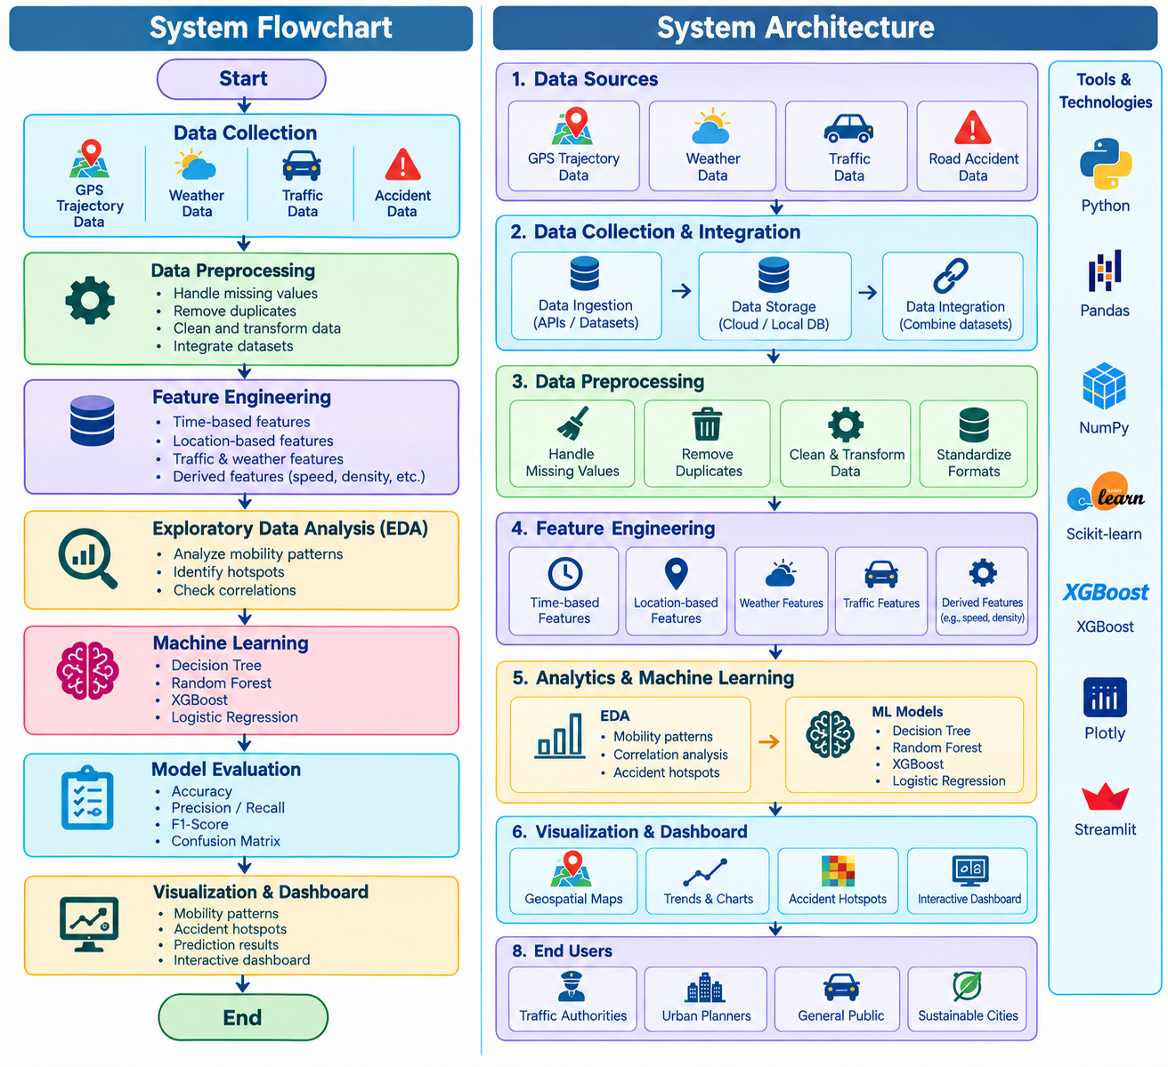
System Design

Slide 14
Modern Tools & Technologies
Category | Tool / Technology | Purpose in the Project
Programming Language | Python | Core language for data analysis, preprocessing, ML, and project implementation
Development Environment | Jupyter Notebook | Interactive data analysis, experimentation, and model development
Data Processing | Pandas | Data loading, cleaning, transformation, and analysis
Data Visualization | Matplotlib,Seaborn | Creating charts, statistical plots, correlation analysis, and heatmaps to visualize and understand traffic and mobility patterns.
Machine Learning | Scikit-learn ,XGBoost | Developing, comparing, evaluating, and improving machine learning models for accident-risk prediction.
Data Storage | CSV | Storing and managing GPS, weather, traffic, and accident datasets
Dashboard | Streamlit | Creating an interactive dashboard for mobility analysis and prediction

Slide 15
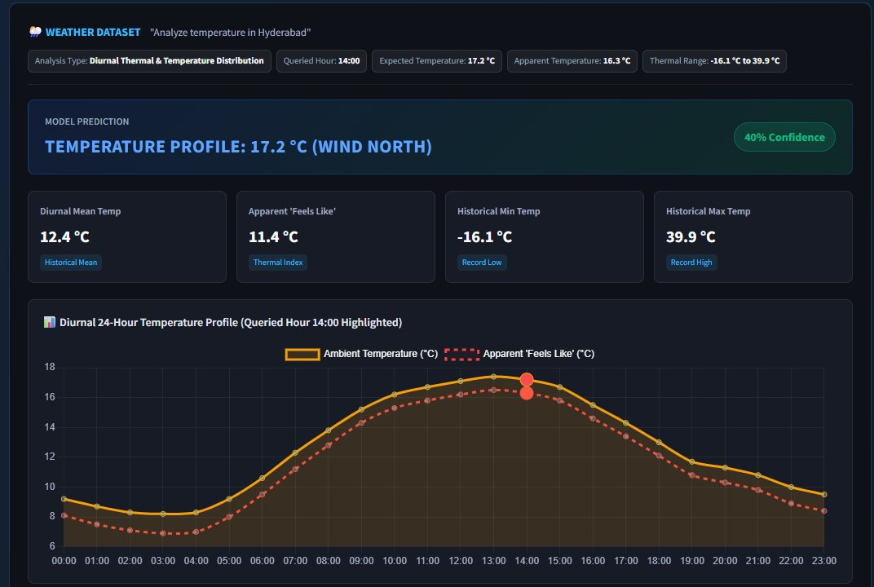
Implementation

Slide 16
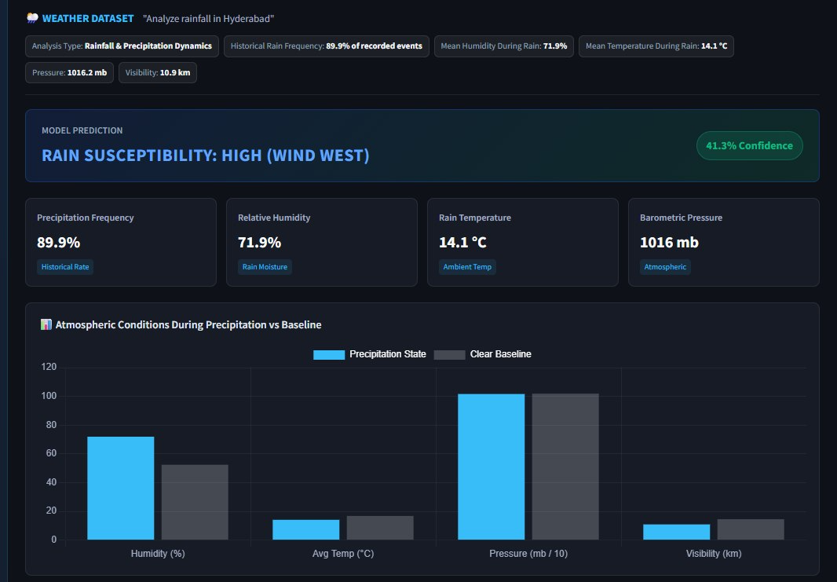

Slide 17
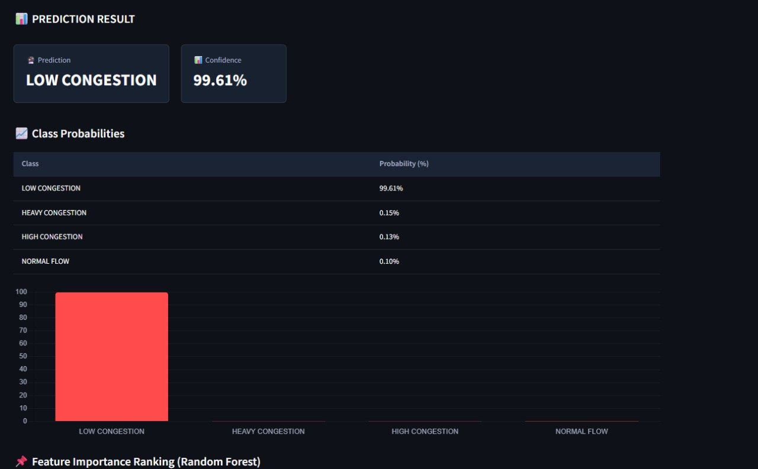

Slide 18
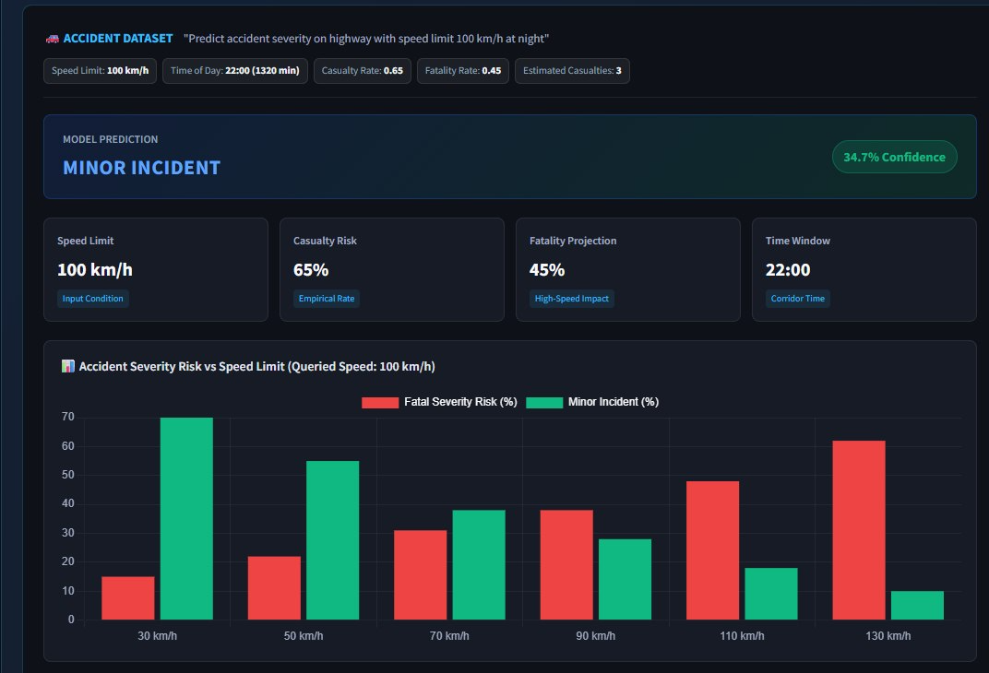

Slide 19
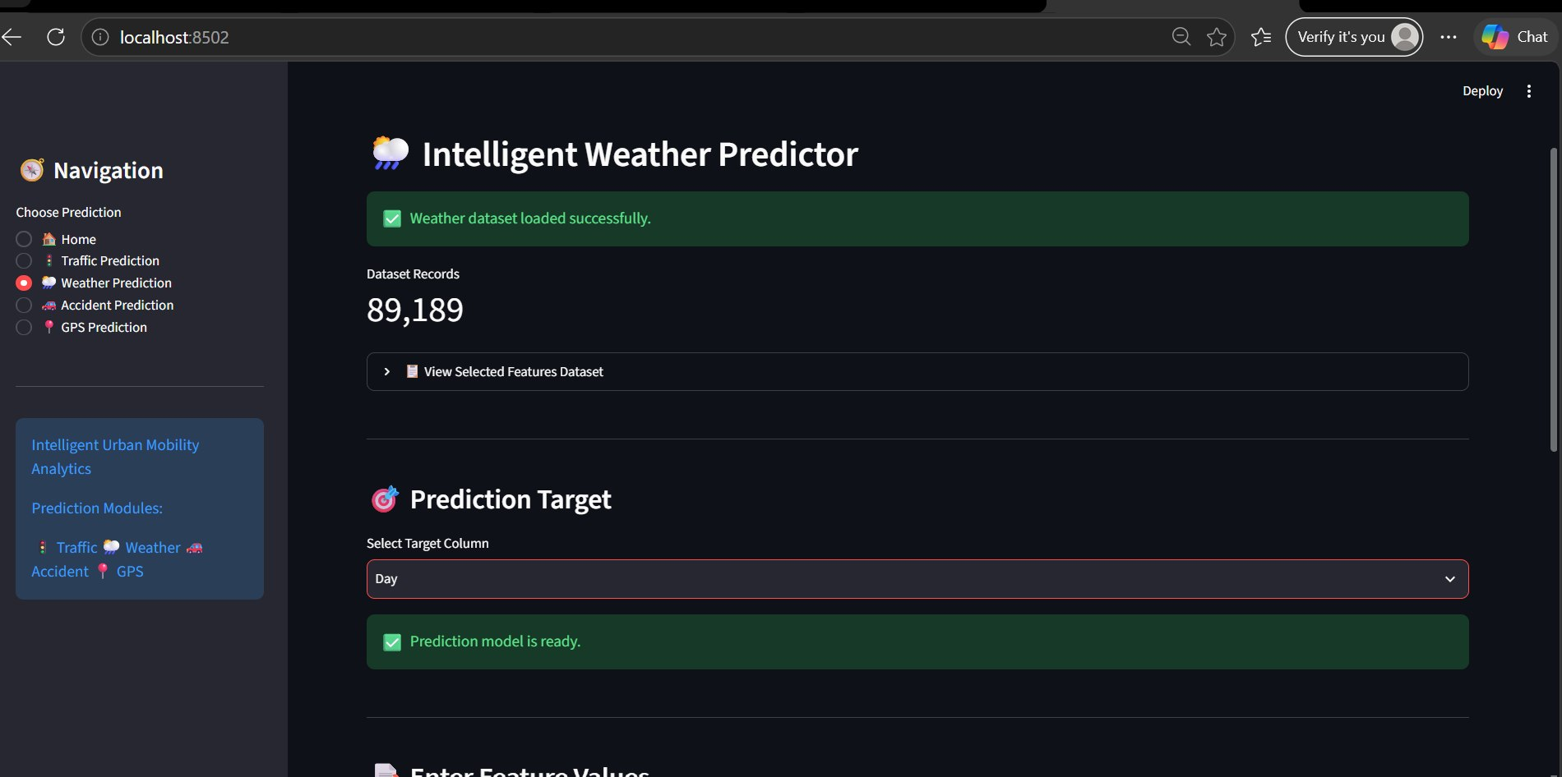

Slide 20
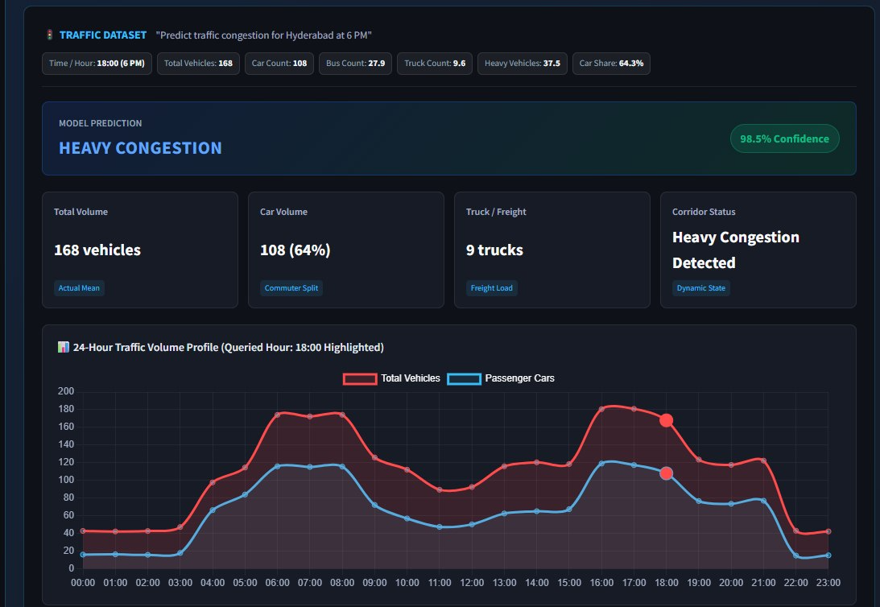

Slide 21
Results
Data Cleaning:
Cleaned GPS, weather, traffic, and accident data by handling missing and invalid records.
EDA Findings:
Identified mobility patterns, traffic conditions, accident trends, and important correlations.
Feature Engineering:
Created useful features from speed, travel time, weather, traffic, and location data.
Feature Selection:
Selected relevant features and reduced redundant data using correlation analysis.
Predictive Modeling:
Compared Decision Tree, Random Forest, XGBoost, and Logistic Regression for accident-risk prediction.
Final Outcome:
Cleaned Data → EDA → Features → ML Prediction → XAI → Dashboard

Slide 22
Performance Evaluation
Model Evaluation
Evaluated Decision Tree, Random Forest, XGBoost, and Logistic Regression models.
Evaluation Metrics
Used Accuracy, Precision, Recall, F1-Score, and ROC-AUC to measure model performance.
Model Comparison
Compared the models based on their prediction performance and reliability.
Confusion Matrix Analysis
Analysed confusion matrices to identify correct classifications and misclassified traffic conditions.
Feature Importance Analysis
Examined important traffic-related features to understand their contribution to the model's predictions.
Final Outcome:
ML Models → Performance Metrics → Model Comparison → Explainable Predictions

Slide 23
Implementation of the proposed hybrid model
The proposed hybrid model integrates GPS, traffic, weather, and road accident data to perform urban mobility and accident-risk analysis. The implementation begins with collecting and preprocessing the datasets by handling missing values, removing duplicates, standardizing formats, and integrating relevant information. Next, feature engineering is performed to extract important mobility, traffic, weather, location, and time-based features. Exploratory Data Analysis (EDA) is then used to identify mobility patterns, traffic conditions, and accident hotspots. For accident-risk prediction, multiple machine-learning models, including Logistic Regression, Decision Tree, Random Forest, and XGBoost, are implemented and compared. The best-performing model is selected based on Accuracy, Precision, Recall, F1-Score, and Confusion Matrix. Finally, the prediction results and mobility insights are presented through geospatial visualizations, charts, accident-hotspot maps, and an interactive Streamlit dashboard.

Slide 24
Experiments Using the Prescribed Datasets
Experiments are conducted using the GeoLife GPS Trajectories, Metro Interstate Traffic Volume, India Road Accident, and Historical Weather datasets. First, the datasets are preprocessed by handling missing values, removing duplicates, correcting data formats, and selecting relevant attributes. The GPS dataset is analyzed to identify travel and mobility patterns, while the traffic dataset is used to study traffic-volume variations and congestion patterns. The accident dataset is used to analyze accident patterns and accident-risk factors, and the weather dataset is used to examine the influence of weather conditions on mobility and road safety. Relevant features from these datasets are then prepared for machine-learning experiments. Logistic Regression, Decision Tree, Random Forest, and XGBoost models are trained and compared for accident-risk prediction. Model performance is evaluated using Accuracy, Precision, Recall, F1-Score, and Confusion Matrix. Finally, the experimental results are presented through charts, geospatial maps, accident-hotspot visualizations, and an interactive dashboard.

Slide 25
Training and testing results
The models were evaluated using accuracy, precision, recall, and F1-score. The Weather dataset achieved moderate performance, with Logistic Regression obtaining the highest accuracy of 67.17%. In contrast, the Accident dataset achieved almost perfect performance, with Logistic Regression reaching 99.75% and Decision Tree, Random Forest, and XGBoost achieving 100%. Similarly, the Traffic dataset showed excellent performance, with Logistic Regression achieving 99.83% and the remaining three models achieving 100%. The reported tables represent the evaluation/testing performance; separate training metrics are required to directly compare training and testing performance and identify possible overfitting.

Slide 26
Comparison with relevant existing models from the literature
Model | Use in Existing Literature | Strength | Limitation Compared with Our Approach
Decision Tree | Accident-risk and severity classification | Simple and interpretable; captures non-linear relationships | Can be sensitive to data variation and may overfit
Random Forest | Accident severity and risk prediction | Robust ensemble model and reduces overfitting | Does not naturally capture complex temporal/spatial relationships
SVM | Accident prediction and severity classification | Effective for complex classification problems | Can become computationally expensive for large datasets
XGBoost | Accident severity, hotspot and risk prediction | Strong performance on structured/tabular data | Requires careful feature engineering and parameter tuning
CNN/LSTM/GNN | Spatiotemporal traffic and accident-risk prediction | Can capture spatial and temporal relationships | More complex and computationally demanding
Proposed Hybrid Models | Integrated traffic, accident and weather analysis | Combines multiple model predictions and supports multi-source analysis | Performance depends on the quality and compatibility of the input datasets

Slide 27
Performance metrics and comparative results
Dataset | Model | Accuracy | Precision | Recall | F1-Score
Traffic | Hybrid Soft Voting | 0.9931 | 0.9901 | 0.9970 | 0.9935
 | Hybrid Stacking | 0.9983 | 0.9980 | 0.9993 | 0.9986
 | Hybrid Weighted Vote | 0.9914 | 0.9864 | 0.9963 | 0.9912
Accident | Hybrid Soft Voting | 0.3167 | 0.3175 | 0.3158 | 0.3163
 | Hybrid Stacking | 0.3583 | 0.3425 | 0.3546 | 0.3248
 | Hybrid Weighted Vote | 0.3200 | 0.3191 | 0.3189 | 0.3186
Weather | Hybrid Soft Voting | 0.4703 | 0.4432 | 0.4322 | 0.4329
 | Hybrid Stacking | 0.4765 | 0.4575 | 0.4272 | 0.4246
 | Hybrid Weighted Vote | 0.4705 | 0.4441 | 0.4387 | 0.4399

Slide 28
Comparison of multiple hybrid combinations
The proposed system compares multiple hybrid ensemble combinations to identify the most effective approach for different prediction tasks. Three hybrid techniques—Hybrid Soft Voting, Hybrid Stacking, and Hybrid Weighted Voting—are evaluated using Accuracy, Precision, Recall, and F1-Score. Hybrid Stacking achieved the best overall accuracy for the Traffic dataset (99.83%), while it also produced the highest accuracy for the Accident (35.83%) and Weather (47.65%) datasets. Hybrid Weighted Voting performed slightly better in terms of Recall and F1-Score for the Weather dataset. This comparison helps identify the most suitable hybrid combination based on the characteristics of each dataset and prediction task.

Slide 29
Justification for selecting the final hybrid model
Hybrid Stacking was selected as the final model based on its overall performance across the evaluated datasets. It achieved the highest accuracy for the Traffic dataset (99.83%), Accident dataset (35.83%), and Weather dataset (47.65%). It also provided strong Precision, Recall, and F1-Score values, particularly for the Traffic dataset, where it achieved an F1-Score of 99.86%. The model combines the strengths of multiple models and is capable of handling complex patterns in the data. Compared with Hybrid Soft Voting and Hybrid Weighted Voting, Hybrid Stacking showed more consistent performance across the different prediction tasks. Therefore, it was selected as the final hybrid model for the proposed system.

Slide 30
literature review
Traffic Accident Prediction Under Extreme Weather (2024): Uses an optimized SVM to predict accidents under extreme weather. It mainly focuses on expressways.
Deep Learning for Accident Prediction (2023): Uses CNN and DNN for urban accident prediction and handles imbalanced data. It has limited multi-source integration.
Vehicle Trajectory-Based Accident Risk Prediction (2025): Uses CNN, LSTM, and GNN with speed, acceleration, and location data. It mainly focuses on vehicle trajectories.
Accident Fatality Prediction (2024): Compares Logistic Regression, Random Forest, and Decision Tree for accident-fatality prediction. It focuses mainly on fatality classification.
Road Accident Severity Prediction (2025): Uses Random Forest and Gradient Boosting for accident severity prediction on Indian highways. It is mainly highway-focused.
Urban Flow Prediction (2020): Reviews machine-learning methods for urban traffic-flow prediction, but does not combine multiple urban data sources.

Slide 31
Literature-based novelty verification
Multi-Source Integration: Existing studies mainly focus on individual datasets or specific problems. Our project integrates GPS, traffic, weather, and accident data in one framework.
Comprehensive Urban Mobility Analysis: Unlike studies focusing only on traffic flow or accident prediction, the project combines mobility patterns, traffic conditions, weather factors, and accident analysis.
Comparative ML Analysis: The project compares multiple machine-learning approaches such as Decision Tree, Random Forest, XGBoost, and Logistic Regression for accident-risk prediction.
Geospatial Insights: The project provides GPS-based route visualization and accident hotspot analysis, extending prediction into spatial mobility insights.
Integrated Dashboard: Existing studies generally present individual analytical results, whereas this project combines predictions, mobility analysis, maps, traffic, weather, and accident insights in an interactive dashboard.

Slide 32
THANK
YOU

